Slide 1
Data Dashboarding
with Plotly for Python
Pamela Pan, Data Services Fellow
pp1813@nyu.edu
Fall 2021, NYU Shanghai Library

Slide 2
Timeline
Data Visualization Series
Data Visualization with Plotly for JavaScript
October 21, 2021
10-11:30 am (90 min)
AB Room 415
Intro to Data Visualization on Web Interfaces
October 15, 2021
9:30-10:30 am (60 min)
AB Room 415
Data Visualization with Plotly for Python
Data Dashboarding with Plotly for
Python
October 21, 2021
10-11:30 am (90 min)
AB Room 415
Repository link

Slide 3

● Plotly for Python
Plotly is a graphing library that binds to many languages, including Python (read more from previous workshop).
Built on D3.js, high interactivity by default
High-level library → Allows concision in code
Interactive, scientific charts

Slide 4
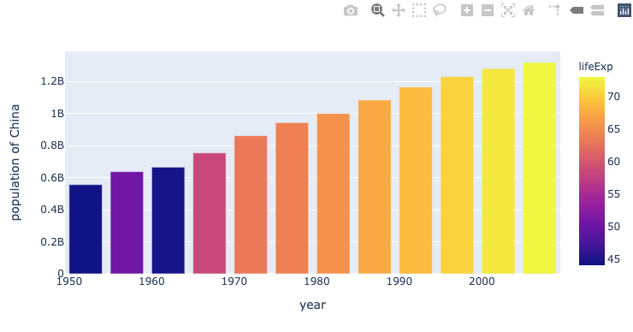
What you see
(Output)
Code behind-the-scenes
(Powered by Plotly Python library)
Entry/ Imported Modules
Structures of Figures
“Plotly figures”
plotly.express*
Plotly Graph Object*
*Recommended entry point, higher-level module, so less code will be written. Will also return fully-populated graph objects.
*Serialized as JSON before being passed onto Plotly.js, which renders the figure under the hood, but we won’t have to interact with it today.
plotly.graph_objects*
*Includes more graph types (e.g. 3-D), but generally needs more lines of code to be written.
Python dictionary*
plotly.figure_factory*
*A lot less convenient, especially in catching errors.
*Includes unique, sophisticated chart types (e.g. subplots, tables) yet to be included in plotly.js.
Notes:
Plotly Python library
(What you’d use to code —create, manipulate, and render— figures)

Slide 5

● Streamlit
Open source app framework, widely used among Data Scientists
All in Python, no front-end experience required
Compatible with many libraries, including Plotly, Bokeh, Altair, Pandas
Notes:
https://docs.streamlit.io/library/get-started/installation#install-streamlit-on-windows

Slide 6
● 5-Step Set Up — Goal
To run the project locally, you will have to clone a GitHub repository (repo) to your local computer instead of creating a React App from the ground up,
The cloned repo contains the Streamlit app (app.py), data (data/Olympics.csv), and the dependencies (Pipfile).
To clone the repo and start running the React App, you will first need to install some softwares and set things up.

Slide 7
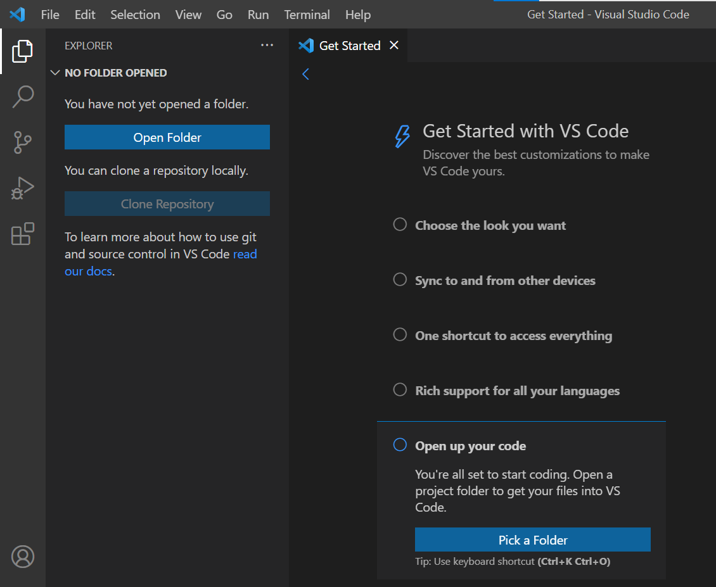
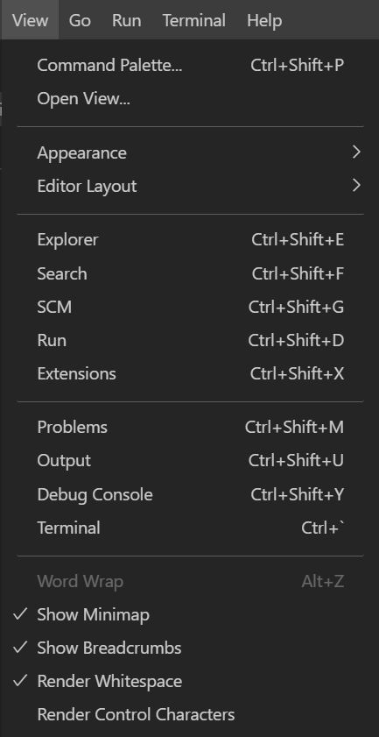
● 5-Step Set Up — Coding Environment (IDE)
Create a GitHub Account if you don’t have one (2 min)
Visual Studio Code: Download & Initialize (5 min)
3. Command Palette
Choose a color scheme of your preference
Sync with other devices, log in with GitHub
Enable Command Palette shortcuts
Open “View” - “Command Palette”
Try searching “view toggle” make Activity Bar invisible
Install language Extensions to save us time when coding
Search “JavaScript Snippets” in Extensions, install it
Search “ES7 React Snippets” in Extensions, install it
Open code by creating/ picking a folder
1. 2.
3.
4.
5.
4. Extensions

Slide 8
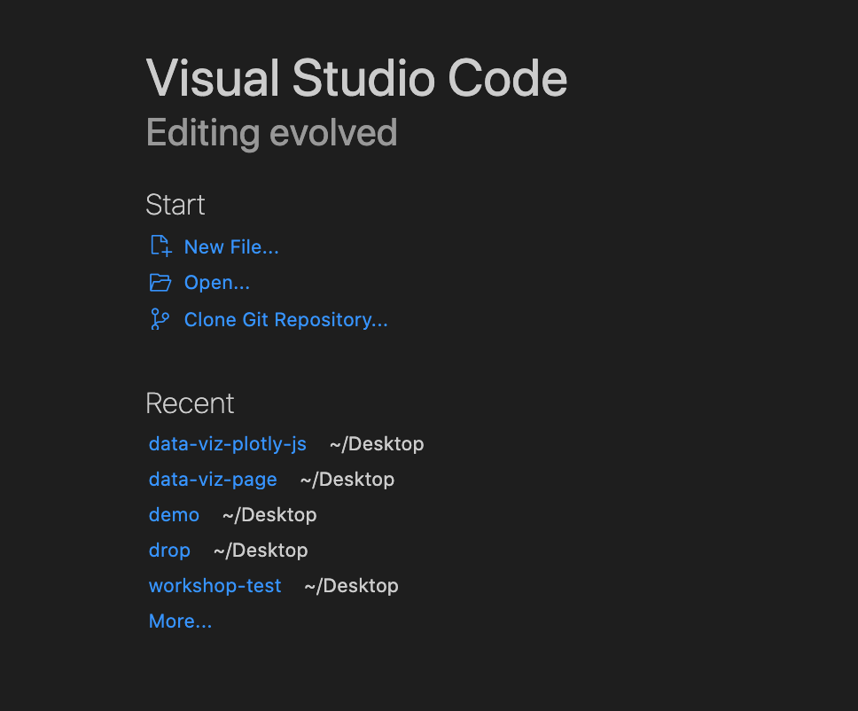
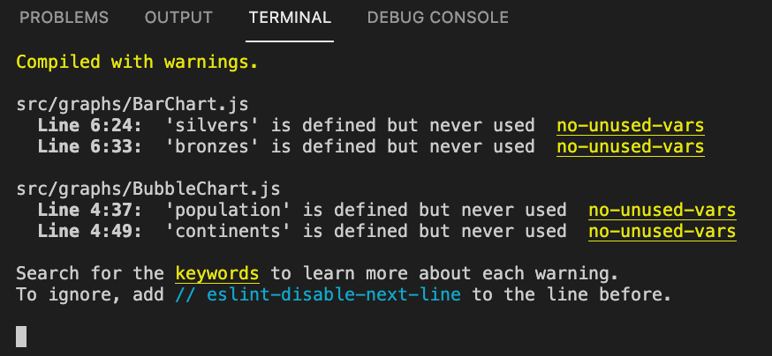
● 5-Step Set Up — Git & GitHub
Install Git, the version control software (2min)
Clone GitHub Repository (make sure you’re logged in w/ GitHub)
Our repo link:
https://github.com/NYU-Shanghai-Data-Services/data-viz-python.git
In “Get Started”, click Clone Repository - Enter repo link
Or copy the following into terminal:
git clone https://github.com/pamela-pan/data-viz-python.git
Choose a folder, open it when you’re done cloning
Enter pwd in terminal (pwd = “print working directory”)
Make sure you’re on data-viz-plotly-js, if not,
type cd data-viz-python (cd = “change directory”)
When you’re done, you should see this in your terminal

Slide 9
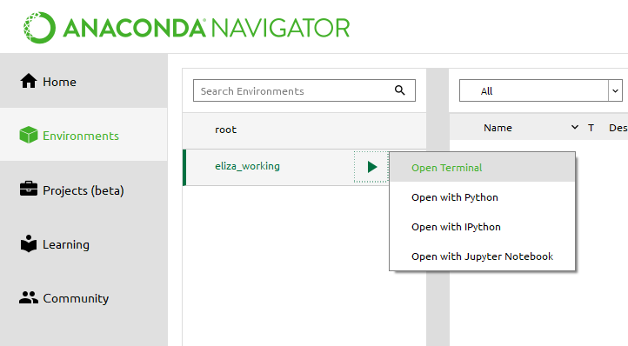
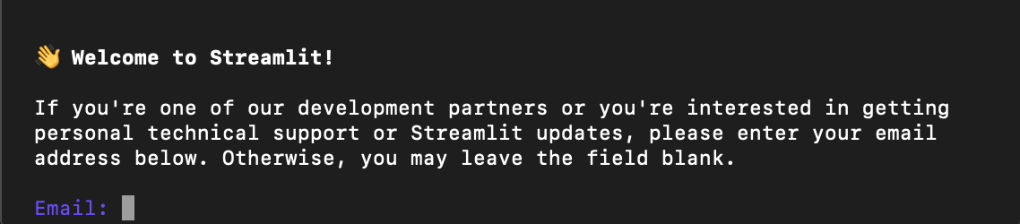
● 5-Step Set Up — Streamlit
macOS/ Linux
Open your computer terminal
(not the one on your text editor)
Install pip (skip if installed):
For macOS, type in terminal:
sudo easy_install pip
For Ubuntu with Python 3:
sudo apt-get install python3-pip
Install pipenv (PIP environment)
pip3 install pipenv
Navigate to your project folder:
cd [folder path]
Create a new Pipenv environment in that folder and activate that environment:
pipenv shell
Install Streamlit:
pipenv install streamlit
Install Plotly, Wordcloud in this Pipenv:
pipenv install plotly
pipenv install pandas
Run our app.py file
streamlit run app.py
Install Streamlit
Windows
Open/ Install Anaconda
Create a new environment with Streamlit
A terminal window will appear, type:
pip install streamlit
Go to your project folder directory:
cd [folder path]
Run the app:
streamlit run app.py
You should see this after you run the app.
Press “Enter” to skip this step.
Notes:
https://docs.streamlit.io/library/get-started/installation#install-streamlit-on-windows

Slide 10
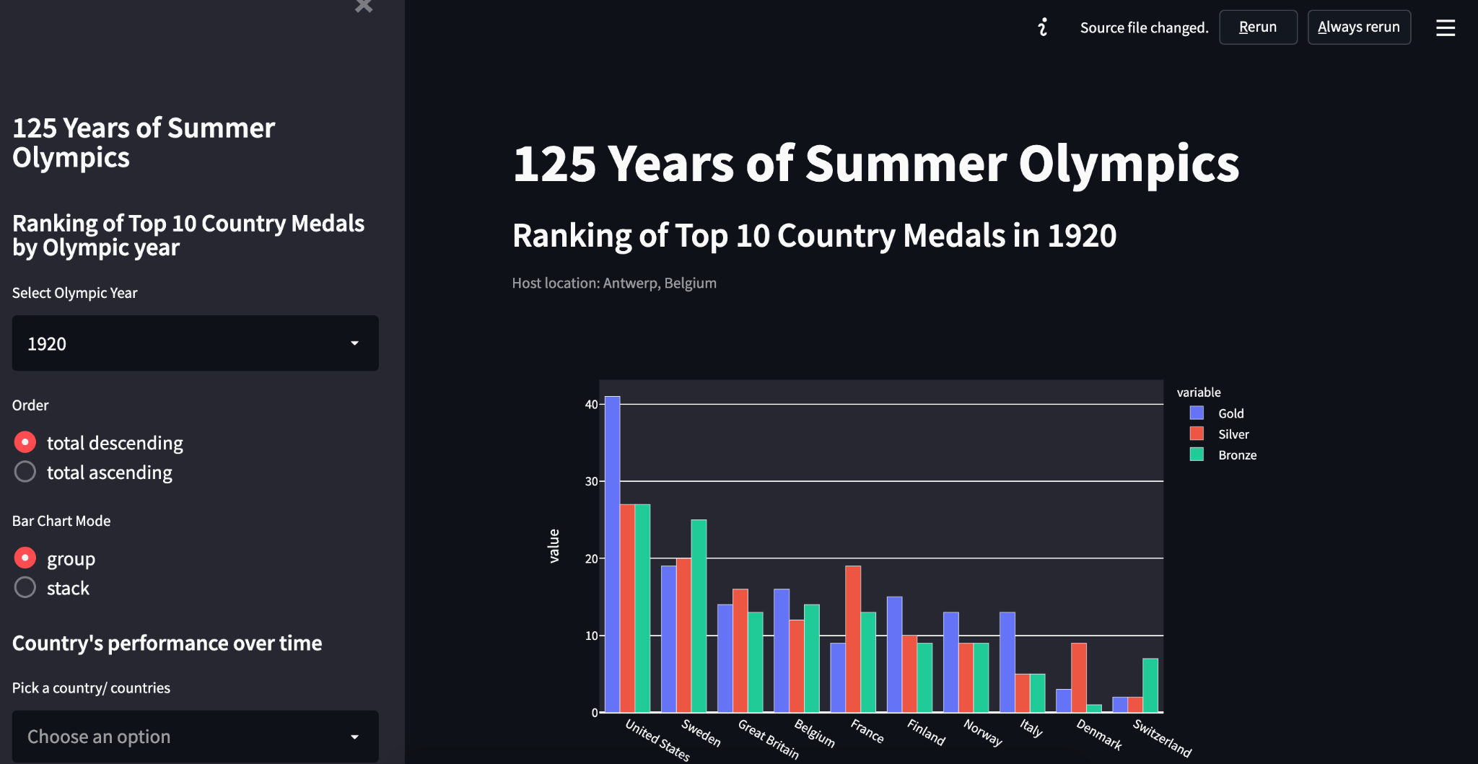
● Troubleshooting & Final view
If you are unable to run, please delete the “Piplock” file.
Settings
This is the browser view after you run the code. You can also change the theme color in the upper-right corner of “Settings”.

Slide 11
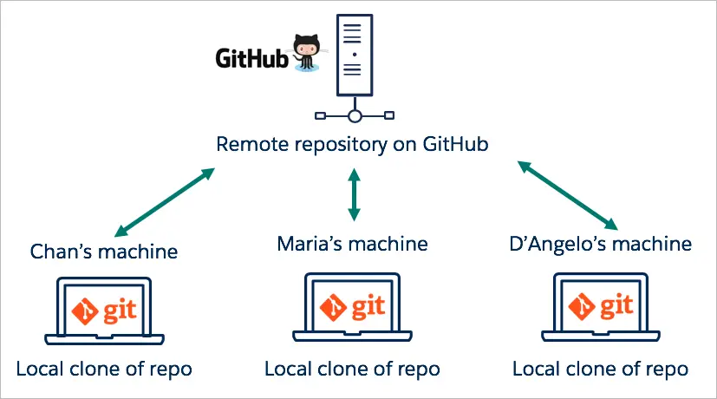
● Understanding Git & GitHub
If you want to create and upload onto your own repo afterwards, check the tutorial here.
Notes:
Perfect for teamwork, or continuing from someone’s project, which is the case today

Slide 12

Thank you!
For any questions, please contact:
👉 shanghai.library.data@nyu.edu
Other workshop resources:
👉 https://nyu-shanghai-data-services.github.io/resources/
Feedback form
tinyurl.com/libworkshopfeedback

